Slide 1
R Clinic
Session 14:
Non-parametric statistics in R

Slide 2
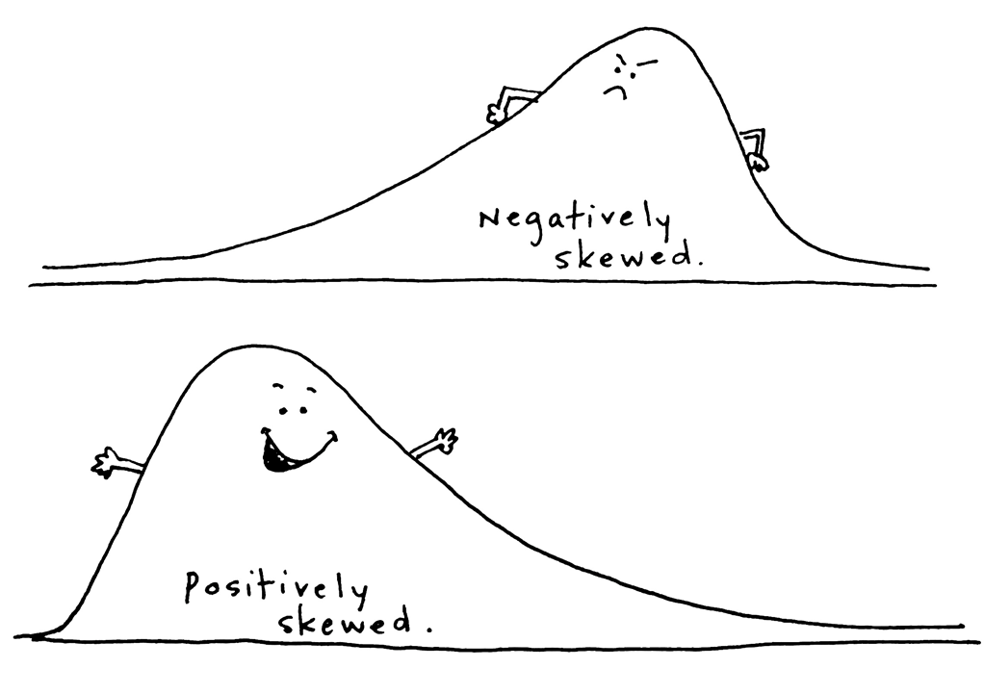
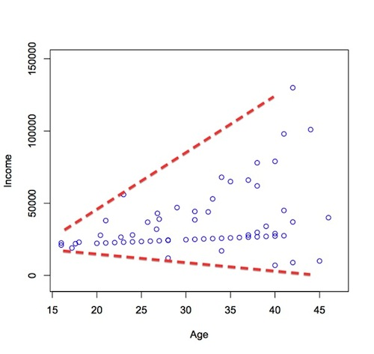
Violating parametric assumptions
Non normal distributions:
Unequal variances:

Slide 3
Non-parametric to the rescue!
Non-parametric tests make less assumptions about the distribution of the data
Based on principle of ranking
Analysis is carried out on ranks rather than the raw data
Used with ordinal data and interval/ratio data that doesn’t meet parametric assumptions

Slide 4
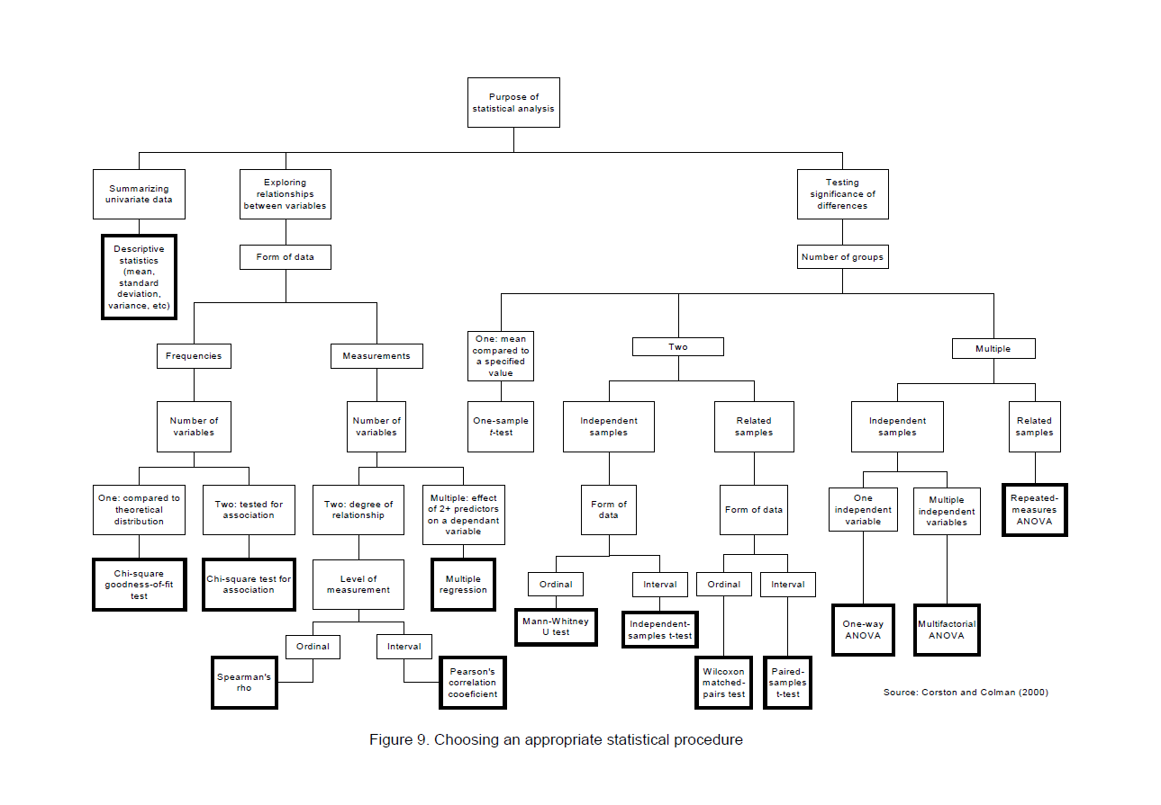
When to use non-parametric tests

Slide 5
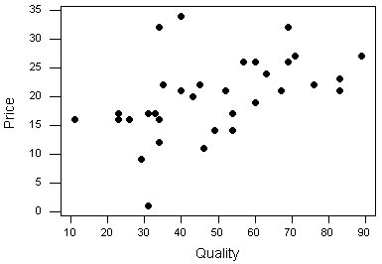
Spearman correlation
Non-parametric version of the Pearson product moment correlation
Spearman’s rho (r_{s}) = measure of the strength of association between two ranked variables
Both variables must be continuous i.e. must be measured on ordinal, interval or ratio scales

Slide 6
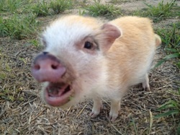
Spearman continued
Example using pig vocalisation data
Recorded grunt rate in two different tests
Is grunt rate in one test related to grunt rate in the other test?

Slide 7
Plot histograms to see distribution of each variable
Neither variable is normally distributed

Slide 8
Run Spearman correlation
Code is in base package
Use “cor.test” and specify “spearman”

Slide 9
Spearman correlation Output

Slide 10
Wilcoxon Rank Sum test
Non parametric version of the independent samples t-test
Examines the difference in the medians between two independent populations
Continuous dependent variable and categorical independent variable

Slide 11
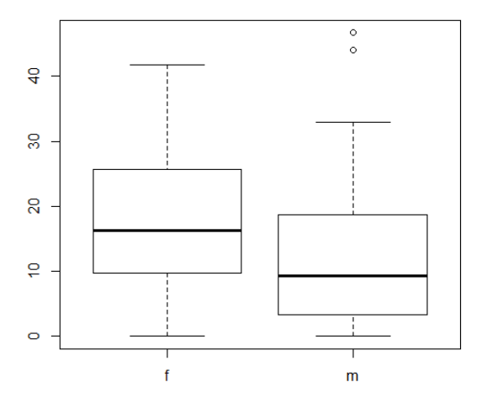
Example:
Is there a difference in grunt rate between male and female pigs?
Use boxplot to look at the medians and check for outliers

Slide 12
Run Wilcoxon rank sum test
Wilcoxon rank sum code:
Output

Slide 13
Wilcoxon matched pairs test
Nonparametric equivalent of paired samples t-test
Use when have repeated observations of same subject
Use immer dataset in MASS package

Slide 14

Wilcoxon matched pairs test
Compare barley yields between year 1 (Y1) and year 2 (Y2)
Test code:
Output:

Slide 15
Kruskal-Wallis test
Non-parametric version of the One way ANOVA
Use when want to compare differences in medians between 3 or more groups

Slide 16

Run Kruskal-Wallis in R
Example using “mpg” dataset in R
Is there a difference in mpg between cars with different drives (e.g. rear wheel, 4 wheel )?
Code for the test:

Slide 17

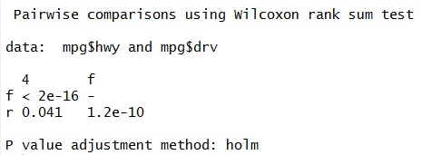
Kruskal-Wallis output
Post-hoc tests to find where difference is:
Output:

Slide 18
Summary
Use non-parametric when:
Ordinal data
Data doesn’t meet assumptions of parametric tests: normal distribution and homogeneity of variance
Nonparametric tests are less powerful than parametric
Tests all in R base package

Slide 19
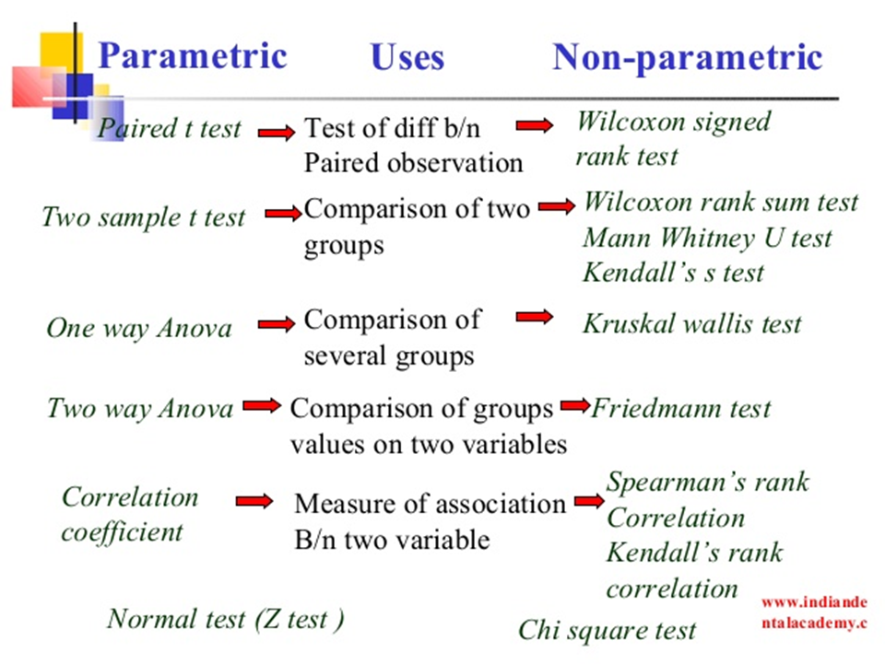

Slide 20

Next week…
Model selection and averaging
Teaching Room 1

